Slide 1



Shopify Analysis
PROJECT BY
BAIG MANZOOR

Slide 2
Shopify Analysis
STEPS IN PROJECT
Requirement Gathering/ Business Requirements
Data Walkthrough
Data Connection
Data Cleaning / Quality Check
Data Modeling
Data Processing
DAX Calculations
Dashboard Lay outing
Charts Development and Formatting
Dashboard / Report Development
Insights Generation

Slide 3
Shopify Analysis
BUSINESS REQUIREMENT
The goal of this project is to analyze Shopify sales data in Power BI to uncover meaningful insights into transaction performance, customer purchasing behavior, and long-term customer value. By designing an interactive dashboard, the objective is to help stakeholders identify patterns in revenue generation, customer retention, and engagement trends to support data-driven decision-making.
KPI’s Requirements
1. Transactions Performance
This section focuses on evaluating the overall health and effectiveness of sales operations by tracking:
Net Sales: Total revenue generated before tax.
Total Quantity: The cumulative number of products sold.
Net Avg Order Value: The average revenue per transaction, excluding tax.

Slide 4
Shopify Analysis
BUSINESS REQUIREMENT
KPI’s Requirements
2. Customer Purchase Behavior
Understanding how customers interact with the business is critical. This section highlights:
Total Customers: The count of unique buyers.
Single Order Customers: Customers who placed only one order.
Repeat Customers: Customers with more than one order, indicating loyalty.
3. Retention & Value KPIs
To evaluate long-term growth and customer value, this section includes:
Lifetime Value (LTV): The total revenue generated by a customer over time.
Repeat Rate: The percentage of customers who return to make another purchase.
Purchase Frequency: How often customers place orders, on average.

Slide 5
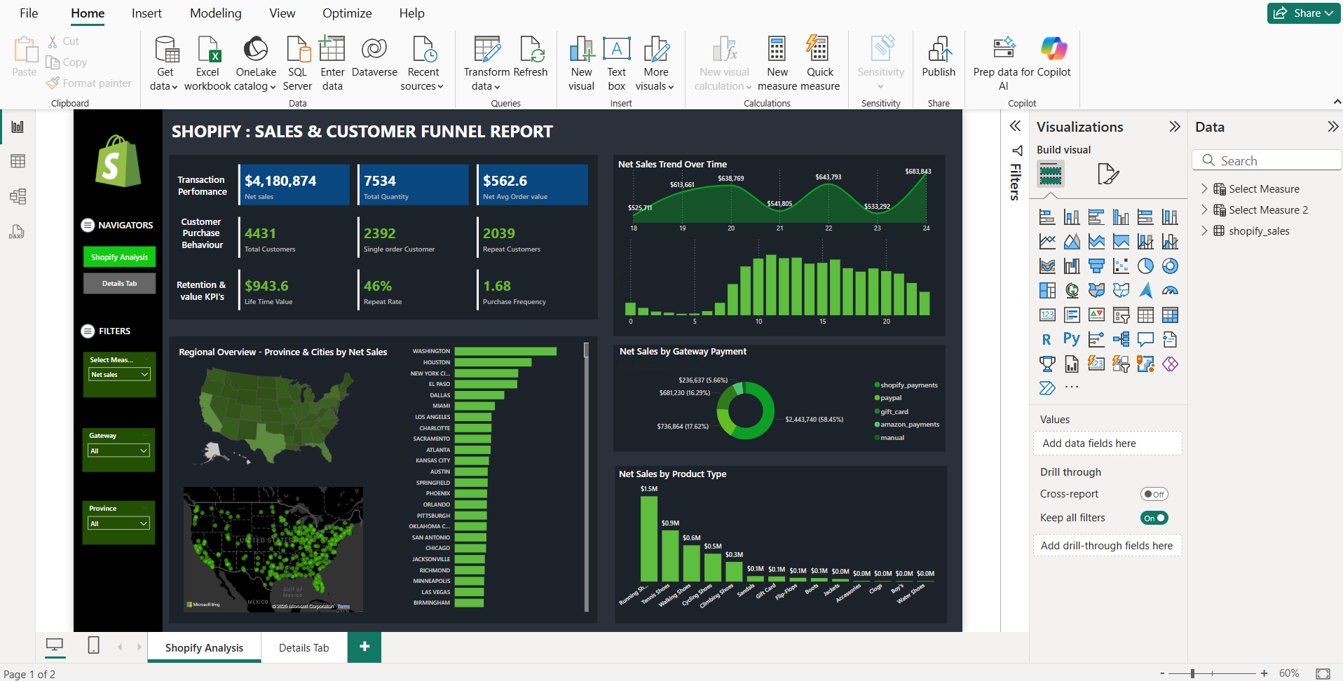
Shopify Analysis

Slide 6
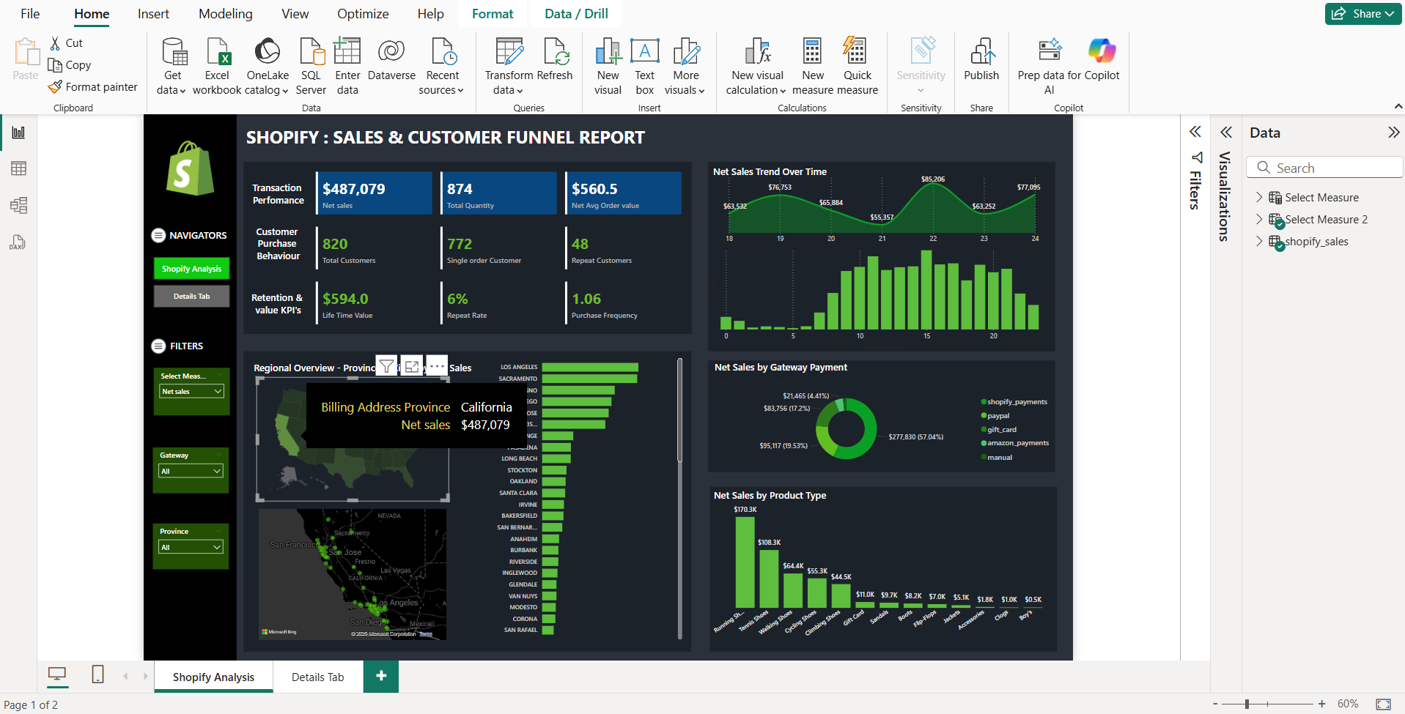
Shopify Analysis

Slide 7
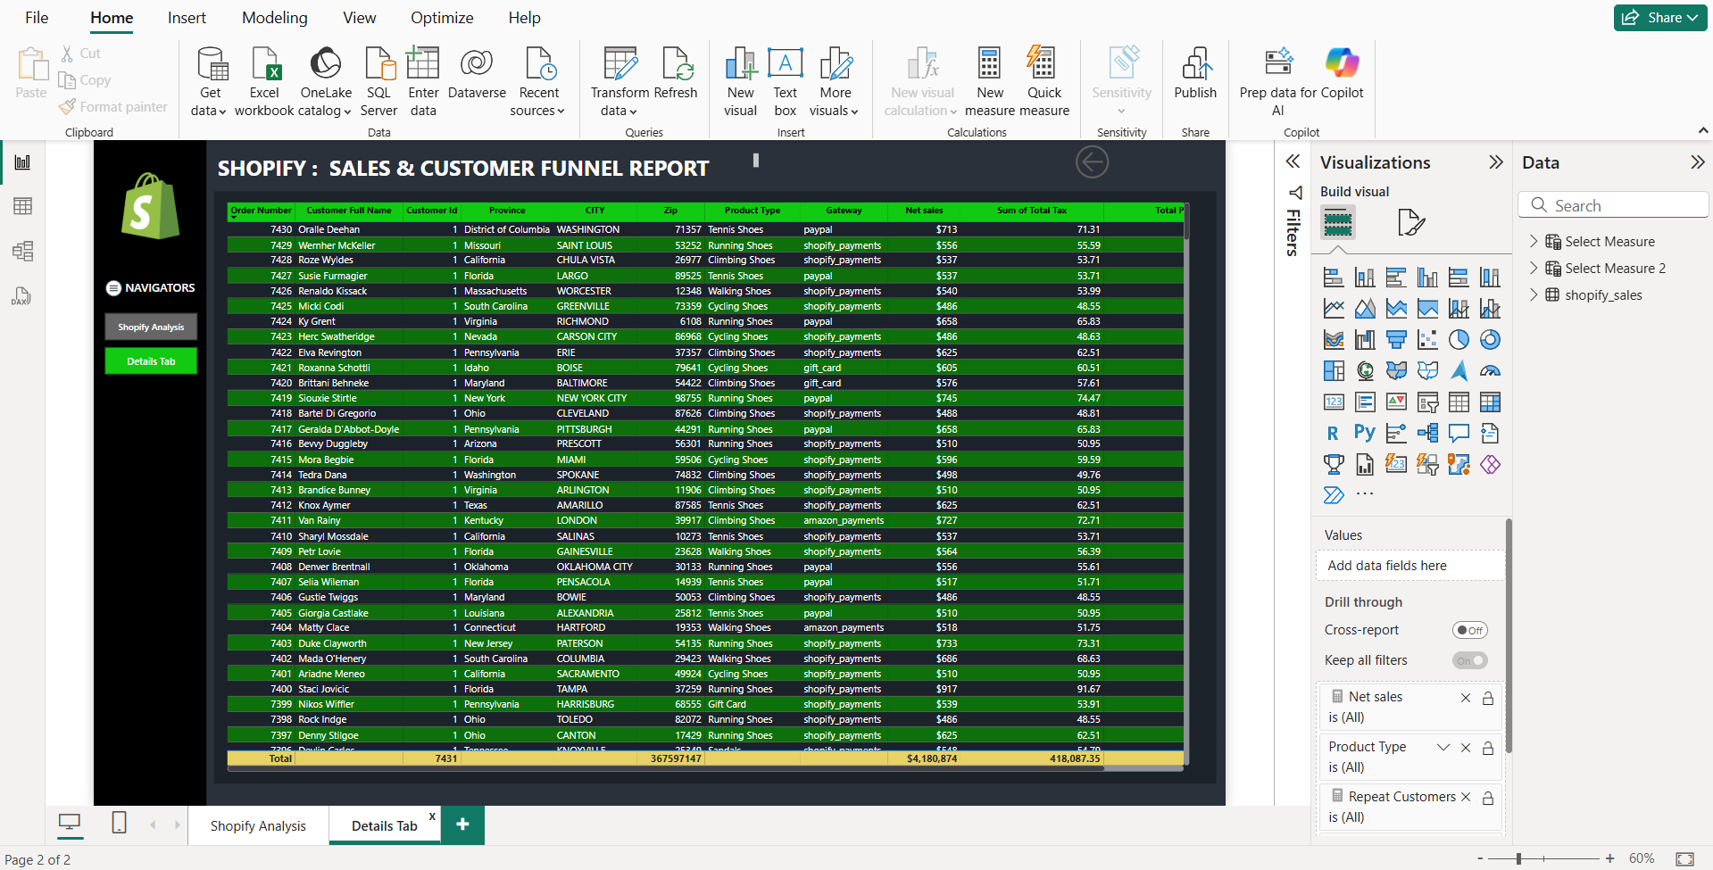
Shopify Analysis

Slide 8
Shopify Analysis
BUSINESS REQUIREMENT
Charts Requirements
This section will support dynamic analysis using a measure selector for: Net Sales, Total Quantity, Total Customers, Repeat Customers
1. Regional Overview - Province and Cities
Filled Map (Province-Level)
Purpose: Display province-wise performance using color saturation based on the selected measure.
Interactivity: Changes dynamically with the measure selector.
Bubble Map / Density Map (City Level)
Purpose: Visually represent sales or customer density at a more granular level.
Bubble Size or Heat Intensity: Driven by the selected measure.
Tooltip: Shows all key metrics (Net Sales, Quantity, Total Customers, Repeat Customers).
Bar Chart (City-Level Performance)
Purpose: Compare top-performing cities based on the selected KPI.
Sorted: Descending order by selected measure.
Dynamic: Interacts with slicers/filters and responds to the KPI selector.

Slide 9
Shopify Analysis
BUSINESS REQUIREMENT
Charts Requirements
This section will support dynamic analysis using a measure selector for: Net Sales, Total Quantity, Total Customers, Repeat Customers
2. Sales Trend Over Time
Area Chart – Trend by Day
Purpose: Show the daily trend of the selected measure (e.g., daily Net Sales or daily Repeat Customers).
Interactivity: Changes dynamically based on the selected measure.
Bar Chart or Line Chart – Trend by Hour
Purpose: Display sales or customer activity by hour of the day (e.g., 0–23 hrs), revealing peak activity periods.
Use Case: Helps understand time-of-day behavior, useful for marketing or operational timing decisions.

Slide 10
Shopify Analysis
BUSINESS REQUIREMENT
Charts Requirements
This section will support dynamic analysis using a measure selector for: Net Sales, Total Quantity, Total Customers, Repeat Customers
3. Gateway Payment Method
Identify the most and least used payment methods.
Detect customer preferences across regions or campaigns.
4. Product Type
Determine which product types generate the highest revenue and order volume.
Understand how customer engagement varies across different product categories.

Slide 11
Shopify Analysis
BUSINESS REQUIREMENT
Charts Requirements
This section will support dynamic analysis using a measure selector for: Net Sales, Total Quantity, Total Customers, Repeat Customers
Provide a dedicated page to display transaction-level or detailed data.
Allow users to drill through from summary visuals (like charts and KPIs) to see underlying records.
Enable users to explore data at a granular level, such as individual orders, customers, or product types.
Help explain summary trends and validate aggregated metrics with raw data.

Slide 12
Shopify Analysis
THANK YOU

